Slide 1


These working materials are part of the toolkit
Climate beyond Classism
transformative educational resources
on classism in the context of the
environmental and climate crisis
When was Class?
A picture and quote guessing quiz on the intersectional history of classism and capitalism
What: Presentation with Quotes, Pictures and Solutions
Date: 04/2026

Slide 2

When was Class?
Guessing the pictures: the intersectional history of classism and capitalism

Slide 3
Introduction
This presentation begins with a possible explanation of the task for the participants, followed by a selection of images and texts that can be used for this method, and immediately afterwards the answer key with background information.
The first slide for each topic always contains two pieces of material, usually an image and a text. These materials are given to the same group one after the other. The second piece of material therefore provides additional information. The material on the left-hand side of the slide should be given to the group first. The material on the right-hand side should be given second, after approximately 5 minutes of working time.
If the text is in italics and enclosed in “ ” it is a quotation; otherwise, it is a description written by us. Additions made for clarity are in [square brackets]. Omissions made for brevity or to aid understanding are indicated by […].
All quotations/events have been translated into English, unless they were originally in English. It is therefore important to inform participants that the context of the quotation cannot always be deduced directly from the words or language used. Where the quotation was available to us in the original language, we have included this in the slide notes as well.
Sometimes, for copyright reasons, images are not inserted directly, but a link is provided as a suggestion for an image. Sometimes there are also alternative suggestions for images in the presentation notes, as well as further background information on the solution.
The source references, as well as the title and any further information, are set up so that they only appear in the presentation with an additional click, and can therefore only be displayed when the solution is revealed..

Slide 4
Task for the Picture/Event-Guessing
Discuss the image/quote/event within your group and consider the following questions:
Image: What can you see? When was the image taken?
Quote/event: Who might have said this? When was it said/when did it happen? Who might have been involved in the event?
What is being said or depicted here, and how does it relate to the topic of climate change and classism?

Slide 5
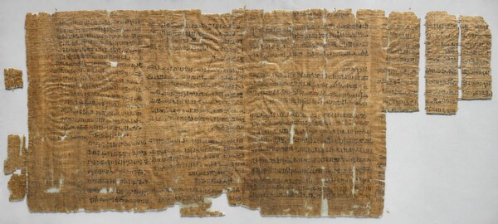
Strike of Deir el-Medina 1159 BC
In the first documented strike in history, around 50 workers stopped work and demonstrated to demand payment of their wages.
https://de.wikipedia.org/wiki/Streik_von_Deir_el-Medineh
Notes:
Bildquelle: https://de.wikipedia.org/wiki/Streik_von_Deir_el-Medineh - verööfentlicht unter CC0 1.0 Universal - https://creativecommons.org/publicdomain/zero/1.0/

Slide 6

Strike of Deir el-Medina 1159 BC
Royal tomb builders worked in mines and were paid in natural goods, which were supplied less and less, or not at all
Five strikes over a three-year period each resulted in their demands being met
-> The exploitation and oppression of workers, as well as resistance, is a very old phenomenon
The so-called ‘Papyrus of the Strikes’, written by Amunnakht between 1187 and 1157 BC, New Kingdom. Museo Egizio, Turin.
https://de.wikipedia.org/wiki/Streik_von_Deir_el-Medineh
Notes:
Alternative image: https://egypt-museum.com/workers-strike-at-deir-el-medina/
The Deir el-Medina strike in the Egyptian workers’ village of Deir el-Medina, which began on 10 Peret II (4 November) 1159 BC[A 1] during the 29th year of Ramses III’s reign, represents the first documented strike in world history. The events are recorded on a papyrus. They worked as royal tomb builders in quarries and on the maintenance of tombs and were originally paid in kind. These payments became less frequent and, in some cases, ceased altogether. Consequently, there were around five strike actions within a period of three years.

Slide 7
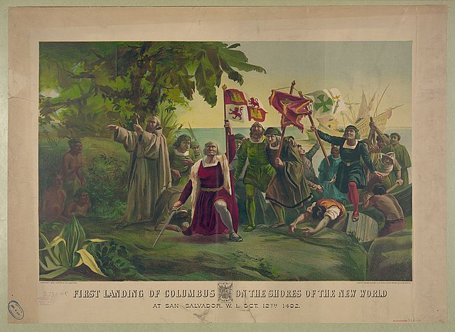
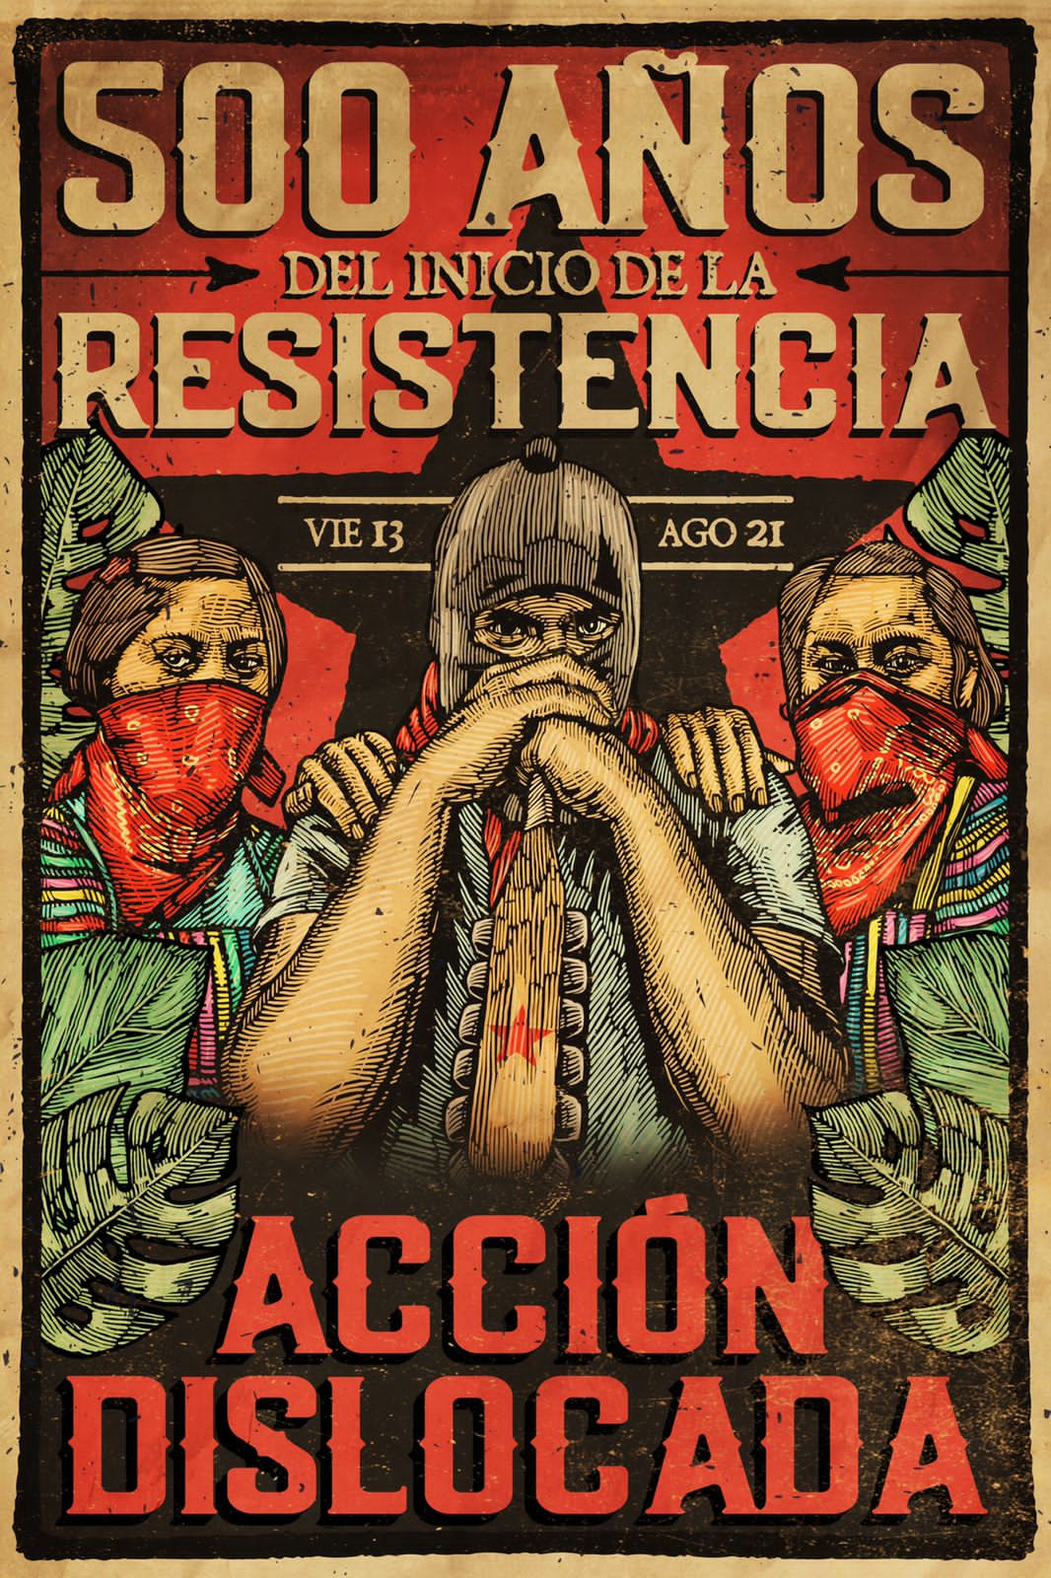
Colonization of Abya Yala (1492)
https://commons.wikimedia.org/wiki/File:First_landing_of_Columbus_on_the_shores_of_the_New_World_At_San_Salvador,_W.I.,_Oct._12th_1492.jpg
http://www.congresonacionalindigena.org/2021/08/13/a-500-anos-del-inicio-de-la-resistencia-no-nos-conquistaron-seguimos-en-resistencia-y-rebeldia-2/
Notes:
Bild 1: https://commons.wikimedia.org/wiki/File:First_landing_of_Columbus_on_the_shores_of_the_New_World_At_San_Salvador,_W.I.,_Oct._12th_1492.jpg
Bild 2: http://www.congresonacionalindigena.org/2021/08/13/a-500-anos-del-inicio-de-la-resistencia-no-nos-conquistaron-seguimos-en-resistencia-y-rebeldia-2/
Public Domain

Slide 8
Colonization of Abya Yala (1492)
Christopher Columbus landed on an Island in the Bahamas, known by its native inhabitants as Guanahani
→ beginning of colonization
Appropriation of land and bans on indigenous forms of land use
Exploitation, displacement and murder
First landing of Columbus on the shores of the New World At San Salvador, W.I., Oct. 12th 1492
https://commons.wikimedia.org/wiki/File:First_landing_of_Columbus_on_the_shores_of_the_New_World_At_San_Salvador,_W.I.,_Oct._12th_1492.jpg
Public Domain
Notes:
Classism is closely intertwined with the history of global exploitation. The exploitation of workers in the colonies and the slave trade thus represent one of the most racist and classist forms of exploitation in history. The construction of classes is therefore also closely linked to the construction of races. At that time, there was no universal suffrage, no labour rights, no universal education, no ban on child labour, no social security, no unemployment insurance…
Establishing the link between climate, class and colonialism: Colonialism is a central historical root of both social and ecological inequality. It created a global system in which wealth, resources and labour were distributed unequally – and this system continues to have an impact to this day.
Exploitation as a dual structure: Under colonialism, it was not only people in the colonies who were exploited, but nature as well. Land was expropriated, forests cleared, monocultures introduced – all for the profit of a few in the Global North. This logic of ‘cheap labour’ and ‘cheap nature’ also shapes capitalism, within which classism operates.
Continuities today: Many regions that were colonised back then are now disproportionately affected by the climate crisis – droughts, floods, loss of livelihoods. At the same time, historically they have contributed very little to global warming. → This is an expression of climate-colonial injustice.
Link to classism: Even within societies in the Global North, colonial logics are reflected in classism: who is considered ‘valuable’ or ‘civilised’, whose labour counts, whose bodies are protected – these hierarchies are closely linked to colonial ways of thinking.

Slide 9

Anti-colonial Resistance
Long history of resistance from indigenous and peasant populations
1989-1992: ‘500 years of indigenous, black and popular resistance’ campaign
Mexico: Zapatista / EZLN with principles of ecology and democracy
Even today, activists are often murdered
http://www.congresonacionalindigena.org/2021/08/13/a-500-anos-del-inicio-de-la-resistencia-no-nos-conquistaron-seguimos-en-resistencia-y-rebeldia-2/
Notes:
Diverse resistance from indigenous and peasant populations.
Zapatista Liberation Army (EZLN): organisation consisting mainly of indigenous people, organises itself in autonomous communities and fights against oppression, land theft, neoliberalism, capitalist and patriarchal conditions. Importance of ecology, democracy, feminism and anti-capitalism.
Still: murder of environmental activists (often indigenous, e.g. Berta Isabel Cáceres Flores – Honduran human rights and environmental activist. murdered in her home by several armed men in 2016.
Murdered Environmental Activists:
- 2000 over the last decade (e360.yale.edu)
- 196 in 2023 (Global witness via statista), highest rates: Colombia (79), Brazil (25), Honduras (18), Mexico (18) → 43% indigenous people, 6% afro-descendants (low estimates)

Slide 10
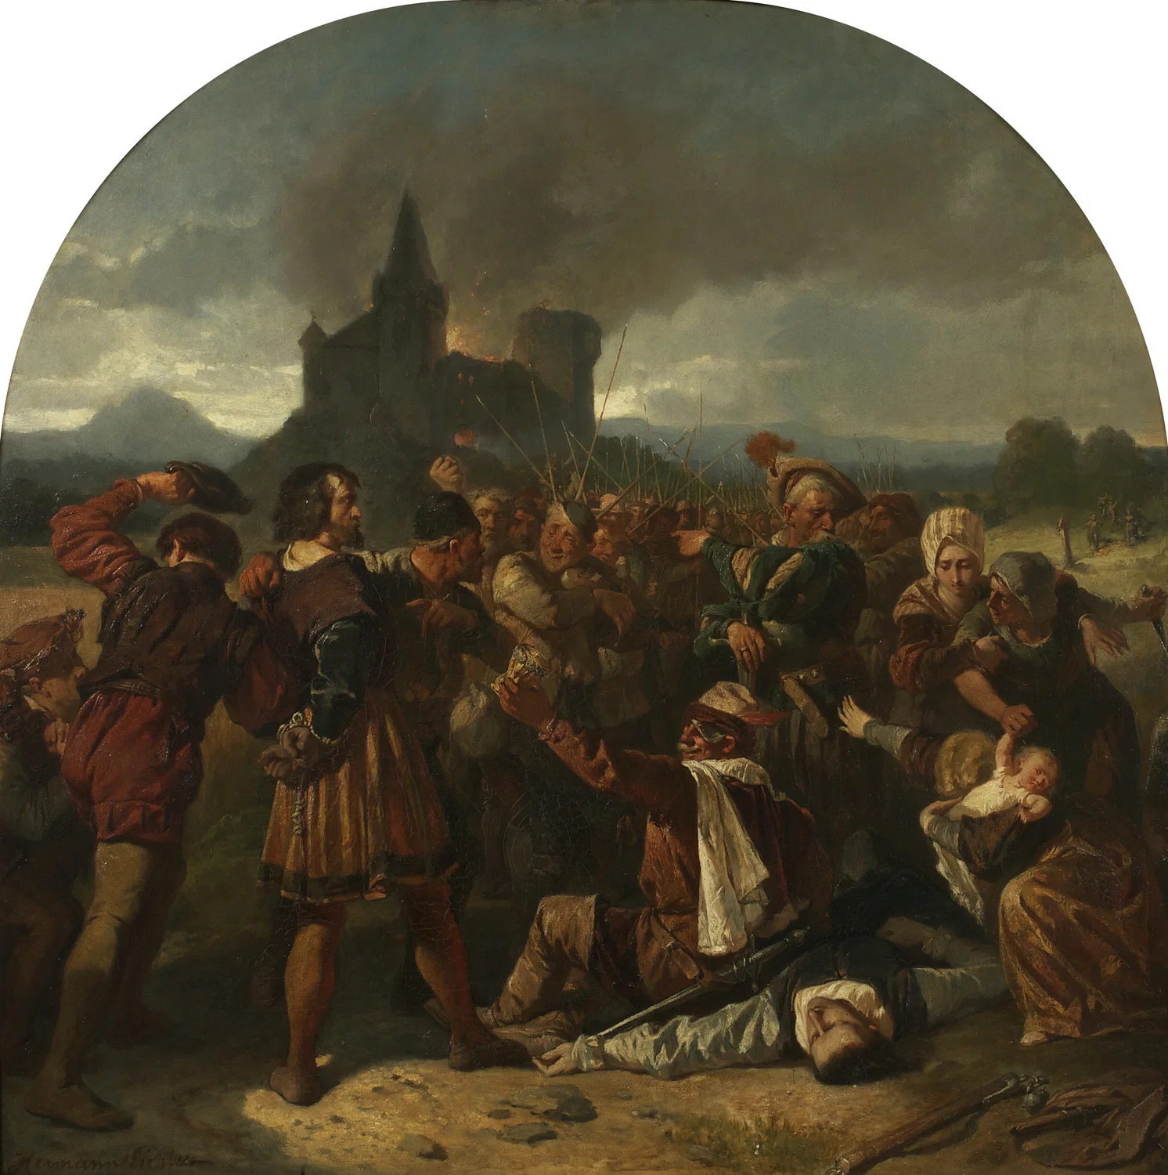
German Peasants’ War(1524 – 1526)
"The root of all thievery are our princes and lords – they claim all creatures as their property: the fish in the water, the birds in the air, the plants on the ground, all must be theirs. But to the poor they say: God has commanded, 'Thou shalt not steal.' Yet they themselves fleece and skin everything that lives. And if a poor man lays hand on the smallest thing, he must hang. And Doctor Liar says 'Amen' to it.”
Episode from the German Peasants' War, oil on canvas painting by Hermann Eichler, c. 1867.
Belvedere, Vienna. Published under the following license: Creative Commons Attribution-ShareAlike.
https://www.worldhistory.org/image/15227/episode-from-the-german-peasants-war/
Notes:
Episode from the German Peasants' War, oil on canvas painting by Hermann Eichler, c. 1867.
Belvedere, Vienna. Published under the following license: Creative Commons Attribution-ShareAlike.
https://www.worldhistory.org/image/15227/episode-from-the-german-peasants-war
Original Quote in German: „Die Grundsuppe der Dieberei sind unsere Fürsten und Herren, nehmen alle Creaturen zu ihrem Eigenthum, die Fische im Wasser, die Vögel in der Luft, das Gewächs auf Erden muß alles ihre seyn. Aber den Armen sagen sie: Gott hat geboten, du sollst nicht stehlen. Sie selber schinden und schaben alles, was da lebt; so aber ein Armer sich vergreift am Allergeringsten, muß er henken. Dazu sagt denn der Doctor Lügner Amen.“

Slide 11
German Peasants’ War (1524 – 1526)
Quote: Thomas Müntzer (Preacher & Revolutinary)
Financing of nobility and church through taxes and levies imposed on peasants; privatization of common land
Peasants organize and loot aristocratic estates
The uprising of 1525 war crushed by military force
Episode from the German Peasants' War, oil on canvas painting by Hermann Eichler, c. 1867.
Belvedere, Vienna. Published under the following license: Creative Commons Attribution-ShareAlike.
https://www.worldhistory.org/image/15227/episode-from-the-german-peasants-war/
Notes:
The quote is attributed to the radical reformation period, often associated with Thomas Müntzer, a preacher and revolutionary who supported the peasants.
Peasants had to financially support the nobility and the church through tithes, taxes, and compulsory labor.
Increasingly, common goods like forests, rivers, and meadows were privatized by rulers and religious institutions – this loss of commons was a key factor in the uprisings.
Peasant groups formed, published demands like the “Twelve Articles”, and began to storm and loot aristocratic estates.
The large uprising in 1525 was violently crushed by princely armies. Tens of thousands of peasants were killed. Müntzer was captured and executed.
🌍 Links to environmental justice and classism
The loss of access to land and resources (commons) is a historical example of environmental injustice tied to social inequality.
Peasants resisted the privatization of what had been shared spaces for subsistence and life – an early form of struggle for the right to a livable environment.
The narrative shows how blame and punishment were unequally distributed: the ruling classes exploited nature and people, while the poor were punished for minor offenses – a pattern that continues in environmental and class-related conflicts today.
The uprising can be read as a historical example of resistance at the intersection of class oppression and environmental dispossession.

Slide 12
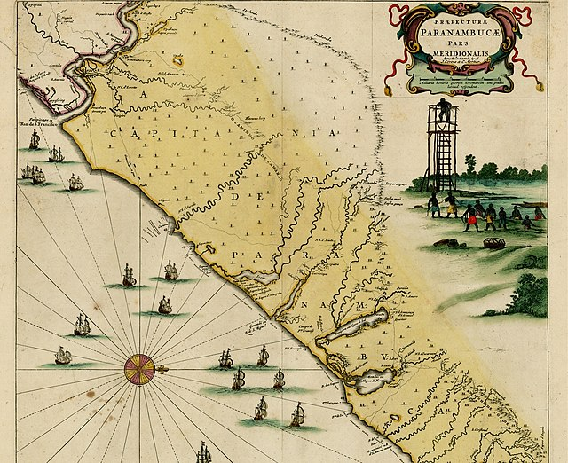
Quilombos (since 17th century)
The Quilombolas' fight since centuries is a fight against racism, against capitalism and for nature.
Map of the Captaincy of Pernambuco showing the Quilombo dos Palmares
https://commons.wikimedia.org/wiki/File:Mapa_da_Capitania_de_Pernambuco,_com_representa%C3%A7%C3%A3o_do_Quilombo_dos_Palmares_(1647).jpg
Public Domain
Notes:
Karte des Kapitänsamtes von Pernambuco, die den Quilombo dos Palmares zeigt https://commons.wikimedia.org/wiki/File:Mapa_da_Capitania_de_Pernambuco,_com_representa%C3%A7%C3%A3o_do_Quilombo_dos_Palmares_(1647).jpg
Public Domain

Slide 13
Quilombos (since 17th century)
Settlements of escaped African slaves and their descendants in Brazil
Between 1.000 and 10.000 Quilombo Territories
many quilombola communities are fighting for land rights, against racism and environmental destruction by corporations and large-scale projects.
constitutionally recognized, successfully fighting large-scale projects, preserving and revitalizing culture and self-organization
Interesectional anticolonial resistance
Karte des Kapitänsamtes von Pernambuco, die den Quilombo dos Palmares zeigt https://commons.wikimedia.org/wiki/File:Mapa_da_Capitania_de_Pernambuco,_com_representa%C3%A7%C3%A3o_do_Quilombo_dos_Palmares_(1647).jpg
Public Domain
Notes:
Quilombos emerged from the 17th century as places of refuge for fugitive slaves - often in remote areas with independent social, cultural and economic structures.
Today, between 1000 and 10000 quilombola communities live in Brazil, many without official recognition or secure land rights.
They are fighting against land grabbing, environmental destruction, monocultures (soy, sugar cane), mining and large-scale projects (e.g. dams, pipelines).Many of these projects not only threaten their existence, but also the biodiversity of the regions.
Quilombola movements such as CONAQ (Coordenação Nacional de Articulação das Comunidades Negras Rurais Quilombolas) campaign for collective land rights, cultural recognition and environmental justice.
Organized together wit indigenous groups in the amazonas
Also existing in other parts of south america
Their resistance is intersectional: it is directed against racist, colonial and capitalist structures. Also internationally networked: part of global movements for environmental justice, indigenous rights and decolonial struggles.

Slide 14
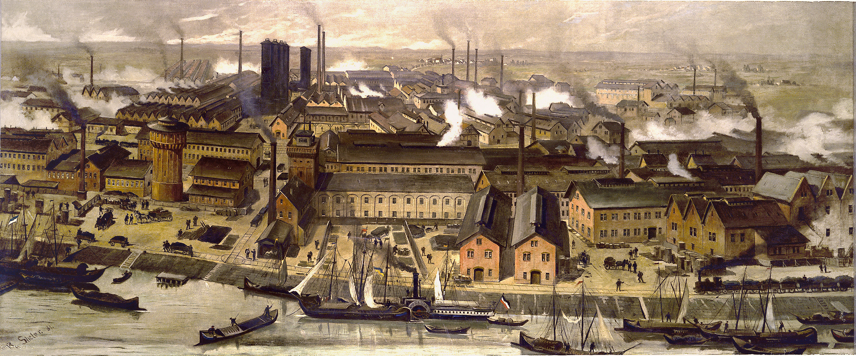
Industrialisation in Europe (19th century)
Coal is becoming the most widely used energy source in Europe.
BASF Ludwigshafen site 1881 – von BASF
Veröffentlich unter CC BY-NC-ND 2.0 Lizenz
https://www.flickr.com/photos/basf/5509563806/
Notes:
BASF Ludwigshafen site 1881 – von BASF
Veröffentlich unter CC BY-NC-ND 2.0 Lizenz
https://www.flickr.com/photos/basf/5509563806/

Slide 15
Industrialisation since 1765
Beginning of industrial capitalism: production in large factories
Coal is used for energy production
Exploitation of workers and the non-human environment
Sickening living conditions in workers' neighbourhoods
Emissions rised since then
BASF Ludwigshafen site 1881 – von BASF
Veröffentlich unter CC BY-NC-ND 2.0 Lizenz
https://www.flickr.com/photos/basf/5509563806/
Notes:
Alternative picture: https://www.hs-nb.de/storages/hs-neubrandenburg/institute/iugr/Landschaft_im_Wandel/Landwirtschaft/Phasen_der_Industriellen_Revolution/Industrialisierung_in_Deutschland.jpg
The industrial revolution (steam engine, coal-fired power) replaced conventional driving forces (people and animals, wind and water) and greatly intensified industrial production. For example, the textile industry was increasingly relocated from the previously small domestic production facilities to large factories, where steam-powered spinning machines and looms quickly and productively manufactured the fabrics that were in demand on the European continent. → Resistance, e.g. in the weavers' uprising of 1844
Technical innovation as an essential feature of the emerging capitalism. Also: Many factories with bad working conditions and living conditions in workers' neighbourhoods. important: industrialisation would not have been possible without the exploitation of resources and people in the colonies.
Also: starting point for many workers' movements in which many workers mobilised to fight against their exploitation and for better working conditions..

Slide 16
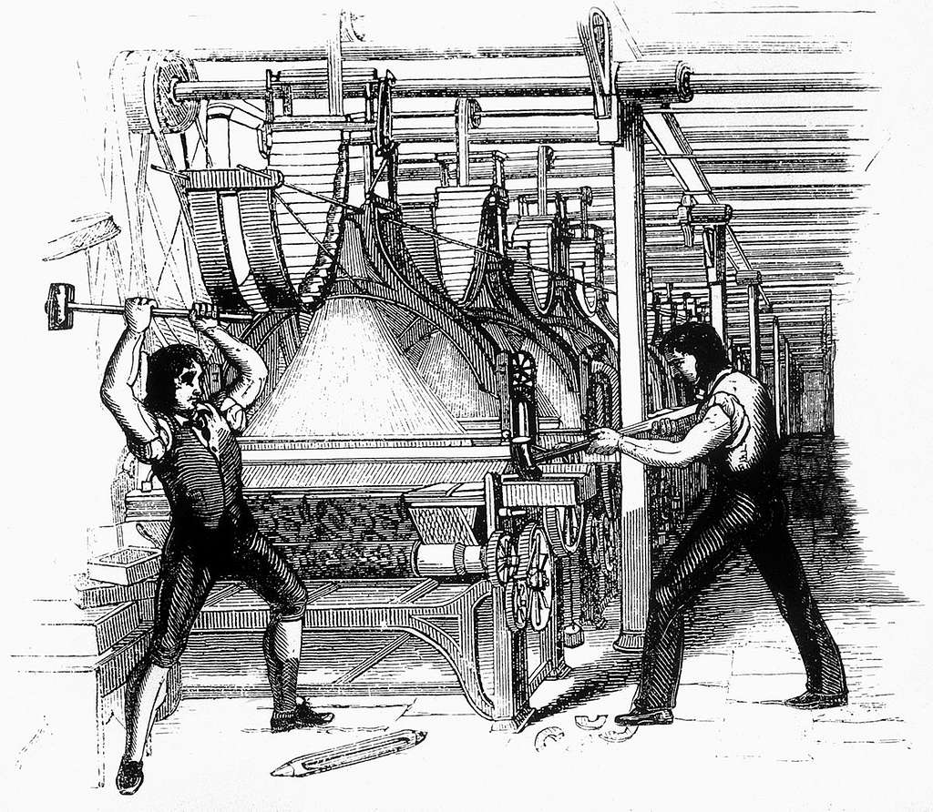
machine destruction movements (early 19th century)
Workers destroy machines or newly built factories to preven manufacturers from replacing skilled workers with unskilled labour, or to protest against deteriorating pay and working conditions.
https://picryl.com/media/framebreaking-1812-9b84c2
Public Domain Image
Notes:
https://picryl.com/media/framebreaking-1812-9b84c2
Public Domain Image

Slide 17
machine destruction movements (early 19th century)
protests against industrialization in Europe
Workers destroyed machines to resist job loss and worsening conditions
Known as the Luddites or the Swing Riots or „Weberaufstände“ (weavers uprising)
Protest against employers replacing skilled workers with cheaper unskilled labour
Protest not against technique itself but against social and structural dimensions
https://picryl.com/media/framebreaking-1812-9b84c2
Public Domain Image
Notes:
https://picryl.com/media/framebreaking-1812-9b84c2
Public Domain Image

Slide 18
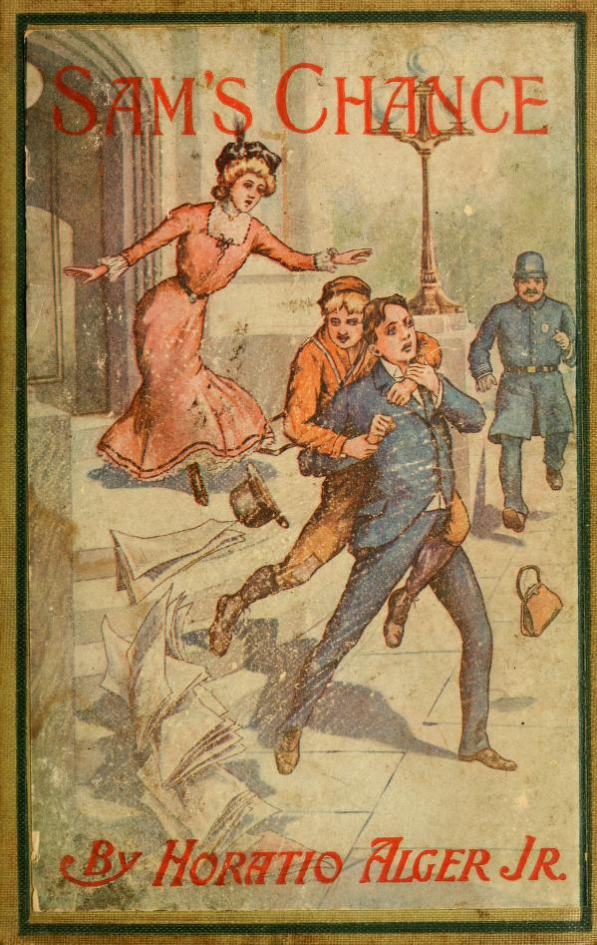
Horatio Algier – 1867 – 1899
An US-American author publishes around 130 stories in which a poor hero works his way out of poverty and into wealth and happiness through hard work and thrift. The saying ‘from rags to riches’ became famous through these stories.
Public Domain Image

Slide 19
Horatio Algiers stories of social advancement
In most stories, upward mobility was achieved by chance and donations from a wealthy person.
From rags to riches – a great myth. Structural inequalities are ignored.
Stories of upward mobility are not the norm.
Pressure and blame on the poor and working classes.
Public Domain Image
Notes:
On average across OECD countries, it would take five generations for children from low-income families to reach the average income level

Slide 20
Mass Tresspass Kinder Scout (1932)
"We ramblers, after a hard week’s work, in smoky towns and cities, go out rambling for relaxation and fresh air. And we find the finest rambling country is closed to us… our request, or demand, for access to all peaks and uncultivated moorland is nothing unreasonable"
This photo of the Mass Trespass on Kinder Scout can be used:
https://www.bbc.com/news/uk-england-derbyshire-61008955
Benny Rothman

Slide 21
Mass Tresspass Kinder Scout (1932)
On 24 April 1932, a group of 400 men and women walked across the moorland of the Peak District, which was then the exclusive property of wealthy gamekeepers
workers demanded public access to land reserved for the wealthy
six protesters were jailed, but the protest sparked public support; inspired the Right to Roam movement & the UK’s first National Park (1951)
Early example of environmental justice: access to nature framed as a class issue
Notes:
When they reached the rocky plateau of Kinder Scout, they were confronted by gamekeepers, which led to physical altercations. Rothman was one of six demonstrators who were imprisoned for taking part in the action. However, the harsh sentences in particular helped to further strengthen the movement and sparked a broad wave of public support. The consequences were far-reaching: the action paved the way for the “Right to Roam” movement, the National Parks and Access to the Countryside Act of 1949, and the establishment of the first national park, the Peak District National Park, in 1951.
Connection to environmental justice & classism
The protest highlighted that access to nature is class-dependent: urban workers had no right to recreation in green spaces. The right to nature was denied from above—the action demanded participation, visibility, and justice for disadvantaged classes. The Mass Trespass was an early form of resistance against environmental injustice—long before the term was established.
Mehr Infos:
https://de.wikipedia.org/wiki/Mass_trespass_of_Kinder_Scout
https://www.bbc.com/news/uk-england-derbyshire-61008955
https://www.muchbetteradventures.com/magazine/the-mass-trespass-of-kinder-scout/
https://britishonlinearchives.com/posts/category/articles/659/right-to-roam-the-kinder-mass-trespass-of-1932

Slide 22
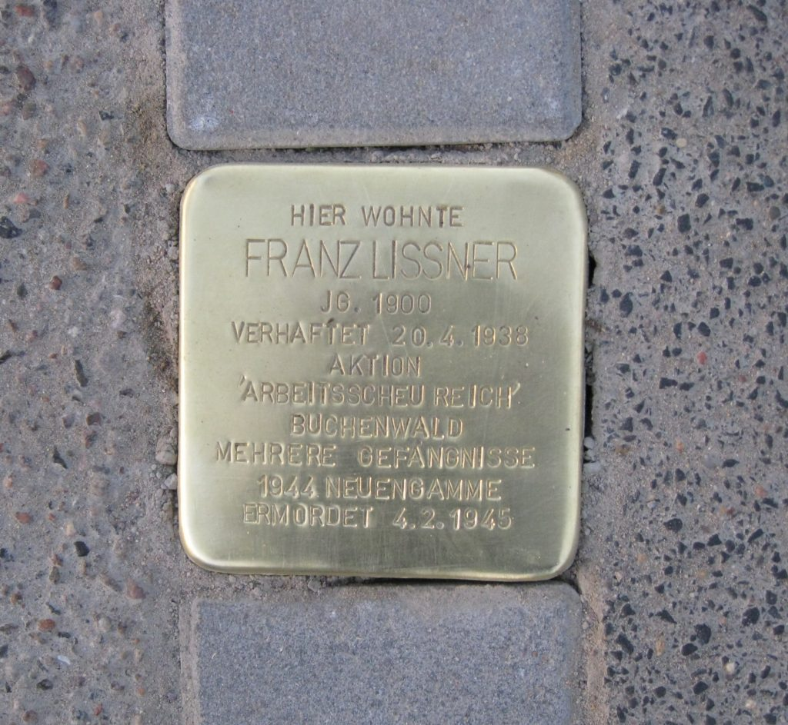
Aktion Arbeitsscheues Reich (Work-shy Reich) 1938
As part of the ‘Arbeitsscheues Reich’ (Work-shy Reich) campaign, more than 10,000 men were deported to concentration camps as so-called ‘asocials’ and forced into hard labour.
Franz Lissner lived here.
Born in 1900.
Arrested on 20 April 1933 during the „Aktion Arbeitsscheu Reich“
Buchenwald.
Several prison terms.
1944 Neuengamme
Killed on 4 February 1945
Published under: Attribution-Share Alike 4.0 International Lizenz
https://commons.wikimedia.org/wiki/File:Stolperstein_f%C3%BCr_Franz_Lissner_%28Uetersen%29.jpg
Notes:
Stolperstein für Franz Lissner in Uetersen (Holstein)
(Foto: Christian Michelides)
Veröffentlicht unter Attribution-Share Alike 4.0 International Lizenz
https://commons.wikimedia.org/wiki/File:Stolperstein_f%C3%BCr_Franz_Lissner_%28Uetersen%29.jpg

Slide 23
Aktion Arbeitsscheues Reich (Work-shy Reich) 1938
Especially men of working age who had twice turned down a job offer or given up after a short time
Ability to work as an important reason for arrest
Also a cover for the arrest and murder of many homeless people, prostitutes, Sinti & Roma, Jews
„Stolperstein“ for Franz Lissner in Uetersen (Holstein)
(Foto: Christian Michelides)
Veröffentlicht unter Attribution-Share Alike 4.0 International Lizenz
https://commons.wikimedia.org/wiki/File:Stolperstein_f%C3%BCr_Franz_Lissner_%28Uetersen%29.jpg
Notes:
'stumbling stone’ /'stumbling block
Historical context
In Germany and Austria, this took place in two waves of arrests. A further 2,000 Jewish men and women were detained in the same operation. These were primarily men of working age who had either turned down a job offer twice or had given up a job after a short time. The grounds for arrest were not the alleged dangerousness of the individual“anti-social” individual, but rather their ability to work was the decisive criterion for arrest. Among those arrested were also beggars and homeless people, prostitutes and pimps, Sinti and Roma, alcoholics, those allegedly “reluctant to work”, people with infectious diseases, etc. In 1943, Himmler himself estimated the total number of imprisoned “anti-social” individuals, “habitual criminals” and those held in preventive detention at around 70,000.
An extreme form of classism, which also manifests itself in hatred, disgust, oppression, exploitation and systemic murder. It is closely linked to other forms of discrimination such as anti-Semitism or anti-Gypsyism (discrimination against Sinti and Roma)..→ It was a targeted social cleansing campaign that combined classism, racism and the ideology of work.
Under National Socialism, work was regarded as a moral duty towards the ‘national community’. Anyone who did not work – or did not work in the manner prescribed from above – was dehumanised and criminalised. Poverty, illness or unemployment were not regarded as social problems, but as signs of personal weakness or ‘inferiority’.
In the camps, forced labour served not only economic exploitation but also ideological ‘re-education’: work was supposedly intended to discipline and ‘purify’. This conception of work as moral purification legitimised systematic violence. → Work became a tool of social and political control.
Even today, traces of this mindset can be found: Those who earn little, are unemployed or receive state support are often morally devalued. At the same time, many socially necessary but physically demanding or poorly paid jobs (care, cleaning, logistics, agriculture) are looked down upon – even though they are central to the functioning of society. → The roots of such hierarchies run deep into the history of discipline through work.

Slide 24
“Wages for Housework”- Campaign (since 1972)
“A woman’s home is not her castle. It is her workplace. But a workplace we pay rent for!”
This photograph, taken by Bettye Lane in March 1977, may be used:
https://hollis.harvard.edu/primo-explore/fulldisplay?docid=HVD_VIA8000904989&context=L&vid=HVD2&lang=en_US&search_scope=everything&adaptor=Local%20Search%20Engine&tab=everything&query=any,contains,wages%20for%20housework&facet=rtype,include,images&offset=0
Notes:
Alternative Picture: https://hollis.harvard.edu/primo-explore/fulldisplay?docid=HVD_VIA8000904989&context=L&vid=HVD2&lang=en_US&search_scope=everything&adaptor=Local%20Search%20Engine&tab=everything&query=any,contains,wages%20for%20housework&facet=rtype,include,images&offset=0

Slide 25
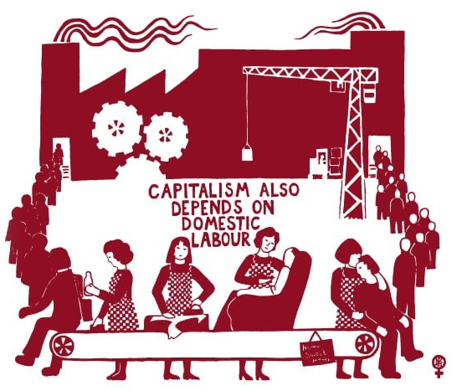
“Wages for Housework”-Campaign (since 1972)
Quote from a leaflet by New York Wages for Housework Committee
Group around Mariarosa Dalla Costa, Silvia Federici, Brigitte Galtier, and Selma James, 1972
Unpaid domestic work is part of exploitation but is not seen as work.
“To say that we want wages for housework is to expose the fact that housework is already money for capital, that capital has made and makes money out of our cooking, smiling, fucking.”
Capitalism also Depends on Domestic Labour. See Red Women’s Workshop,
1976. TWL.2003.197.a, LSE Library
https://seeredwomensworkshop.wordpress.com/
veröffentlicht unter Creative Commons Attribution-NonCommercial-ShareAlike 3.0 Unported License
Quote Source: https://pbs.twimg.com/media/EDZfY-YWsAEkhus.png

Slide 26
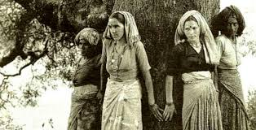
Chipko Movement (India, since 1973)
Activists prevented deforestation for industrial production by using the tactic of hugging trees.
Photo of a Chipko Movement protest in Uttar Pradesh in 1973
Published under a CC BY-SA 4.0 licence
https://snl.no/Chipko-bevegelsen

Slide 27
Chipko Movement (India, since 1973)
A movement of villagers (especially women) in the Uttarakhand region of India against commercial logging
Threats to their livelihoods due to flooding, water shortages, erosion, and the prohibition of using the forest themselves
Emergence of ecofeminist movement that address the exploitation of both women and nature together
Photo of a Chipko Movement protest in Uttar Pradesh in 1973
Published under a CC BY-SA 4.0 licence
https://snl.no/Chipko-bevegelsen
Notes:
Name of the movement: Hindi for ‘to hold on’ or ‘to stick to’Against this backdrop, the first spontaneous Chipko action took place in April 1973 in the village of Mandal in the Alakananda Valley. There, a sports equipment company had been granted a concession to use the forest, which had previously been denied to the villagers when they sought to harvest timber for making tools.
Grassroots Environmental Resistance: The Chipko Movement emerged in the 1970s in rural, forest-dependent communities in Uttarakhand, India. Villagers — especially women — resisted the commercial exploitation of forests by hugging trees to prevent them from being cut down.
Gender & Class Dimensions: Most activists were rural women from lower-income backgrounds whose lives directly depended on access to firewood, fodder, and clean water. These communities were excluded from decision-making, whilst profits from deforestation went to industrial elites.
Environmental Justice Link:nThe movement exposed inequities in resource distribution, where those who caused the least environmental degradation (local communities) suffered the most from its impacts — such as erosion, floods, and water scarcity.
Ecofeminism & Intersectionality: The Chipko movement inspired ecofeminist thinking, drawing attention to how patriarchal capitalism exploits both nature and marginalised genders. It is an early example of intersectional environmental activism.
Legacy: The movement led to bans on deforestation in certain regions and re

Slide 28
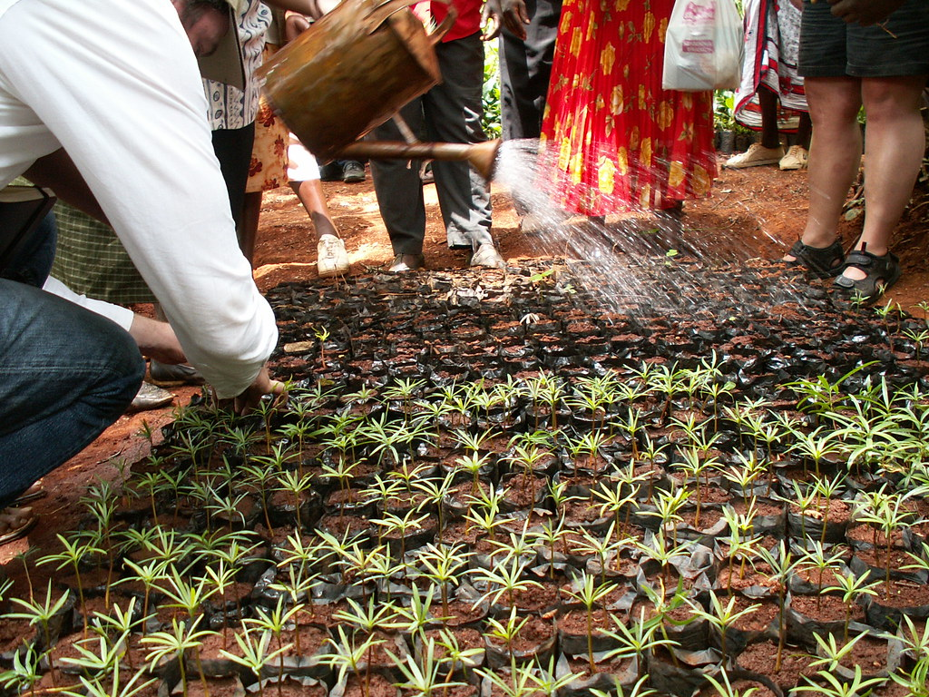
Green Belt Movement (since 1977)
“Trees are living symbols of peace and hope. A tree has roots in the soil yet reaches to the sky. It tells us that in order to aspire we need to be grounded...”
Wangari Maathai
https://www.flickr.com/photos/skasuga/375495241
Public Domain
Zitatquelle: https://www.goodreads.com/author/quotes/117297
Notes:
https://www.flickr.com/photos/skasuga/375495241 Photo: Flickr, CC Liszenz
Quote:: https://www.goodreads.com/author/quotes/117297.Wangari_Maathai
Orginalzitat auf englisch: “Trees are living symbols of peace and hope. A tree has roots in the soil yet reaches to the sky. It tells us that in order to aspire we need to be grounded...”

Slide 29
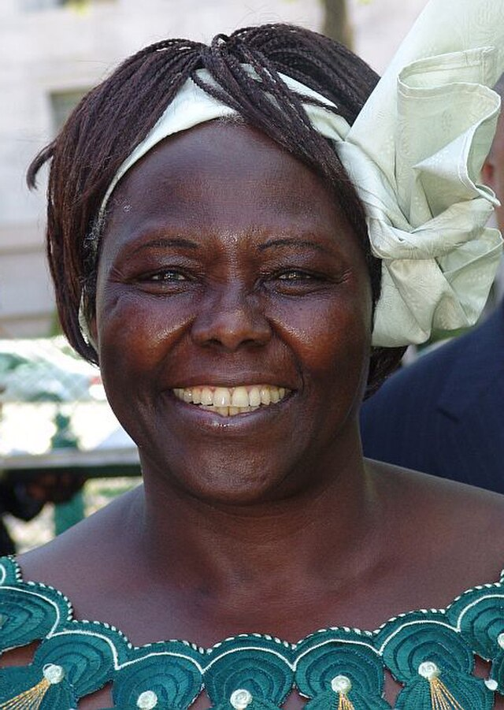
Green Belt Movement/Wangari Matthai
Planted more than 50 million trees since 1977 to stop deforestation, to stop soil erosion, secure water supplies and generate income
movement combined ecological concerns with women's rights, social justice and democracy movements.
More than 30.000 women have been trained in forestry, food processing, bee-keeping…
Wangari Matthai won the Nobel peace price for this project
https://commons.wikimedia.org/wiki/File:Wangari_Matthai_2001_(cropped).jpg
Notes:
The Green Belt Movement was founded in 1977 by Wangari Maathai, the first African woman to win the Nobel Peace Prize (2004).
The movement began by mobilizing rural women in Kenya to plant trees to combat deforestation, soil erosion, and water scarcity.
It quickly evolved into a broader grassroots movement addressing women’s empowerment, climate resilience, and human rights.
The GBM promoted community-based solutions to environmental destruction — especially led by those most affected: poor, rural women.
Maathai linked environmental degradation directly to economic injustice, patriarchy, and corrupt political systems.
She faced political repression, arrests, and state violence for her activism — particularly during the Moi regime in Kenya.
GBM has led to the planting of over 50 million trees and inspired global movements for eco-justice and intersectional activism.

Slide 30
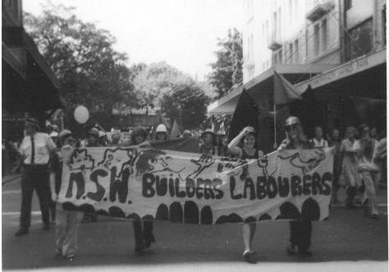
Green Bans Movement, 1970‘s
New office blocks, shopping centres and luxury flats are to be built. Construction workers are expected to destroy more and more green spaces, older shops and residential buildings to do so. For that reason, they refuse to work on projects that are environmentally or socially problematic.
NSW Builders Labourers March
Female members of the NSW branch of the Builders Labourers Federation marching on International Women’s Day in Sydney, March 1975.
Veröffentlicht unter Attribution-Share Alike 3.0 Unported l https://commons.wikimedia.org/wiki/File:NSW_Builders_Labourers_march_on_IWD_1975.jpg
Notes:
NSW Builders Labourers March
Weibliche Mitglieder der NSW Branch of the Builders Labourers Federation in beim Marsch zum Internationalen Frauentag in Sydney, März 1975.
Veröffentlicht unter Attribution-Share Alike 3.0 Unported l https://commons.wikimedia.org/wiki/File:NSW_Builders_Labourers_march_on_IWD_1975.jpg

Slide 31
Green Bans Movement, 1970er
New South Wales Builders Labourers Federation (NSWBLF): Engagement with urban planning
Principle of social responsibility of labour: right of workers to insist that their labour is not used in harmful ways
Protest against ecological destruction often from poverty & working class backgrounds (those who are affected)
Shows the power of strikes
NSW Builders Labourers March
Female members of the NSW branch of the Builders Labourers Federation marching on International Women’s Day in Sydney, March 1975.
Veröffentlicht unter Attribution-Share Alike 3.0 Unported l https://commons.wikimedia.org/wiki/File:NSW_Builders_Labourers_march_on_IWD_1975.jpg
Notes:
More Information: https://www.labornotes.org/2020/07/australian-green-bans-when-construction-workers-went-strike-environment
The construction workers of Sydney were organized in the New South Wales Builders Labourers Federation (NSWBLF).
Since the mid-1960s, the union had increasingly engaged with urban planning issues.
In May 1970, the NSWBLF board decided to develop a "new concept of the trade union movement," which included the principle of social responsibility in labor: according to this, workers have the right to insist that their labor power is not used in harmful ways.
Three main types of construction bans:
for the protection of open spaces;
for the protection of existing housing from being demolished for highways or high-rise buildings
for the protection of older buildings from being replaced by office buildings or shopping centers.
Resistance movement of the impoverished and working classes. Resistance has always been a part of class exploitation and environmental destruction.
Particularly, protest and resistance against environmental destruction often also come from the impoverished and working classes, due to greater exposure and impact. This also demonstrates the power of workers.

Slide 32
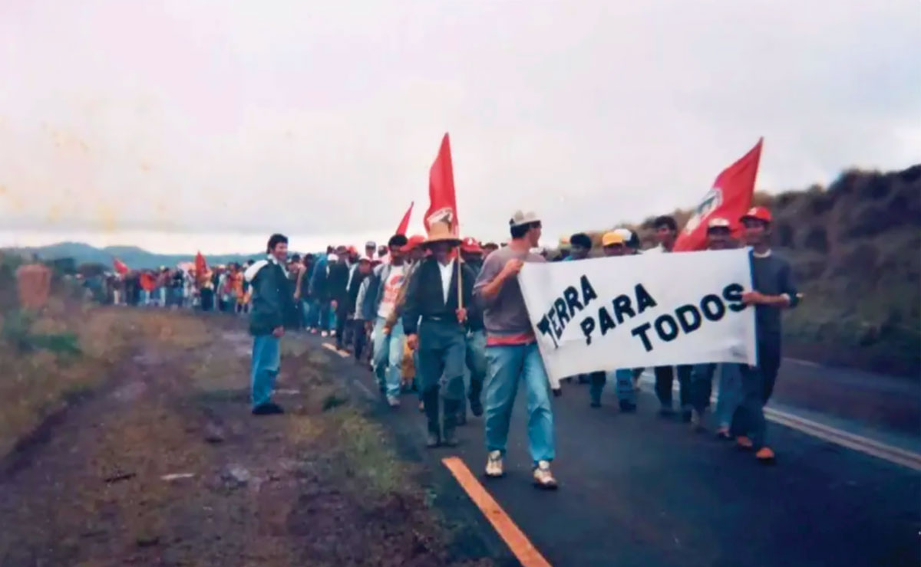
Landless Workers Movement, Brazil (since 1984)
Translated Poster: Land for All
We are “a mass, autonomous social movement that seeks to articulate and organise rural workers and society to achieve Agrarian Reform and a People's Project for” the country.
Land für alle: Mitglieder der MST marschieren im Jahr 1984, dem Gründungsjahr der Organisation. https://mst.org.br/2025/04/09/this-land-is-our-land/
MST Archive
Notes:
Quote:: https://mst.org.br/quem-somos/ -
https://mst.org.br/2025/04/09/this-land-is-our-land/
Photo: MST Archive – Usage just for „non-profit und educational reasons“.
Original quote on portugese: O Movimento dos Trabalhadores Rurais Sem Terra (MST) é um movimento social, de massas, autônomo, que procura articular e organizar os trabalhadores rurais e a sociedade para conquistar a Reforma Agrária e um Projeto Popular para o Brasil.

Slide 33
Landless Workers Movement, Brazil (since 1984)
Movimento dos Trabalhadores Rurais Sem Terra (MST)
Fighting for Land for all, agrarian reform, food sovereignty, equal rights and a people-centered model of development
10% of the population owns 80% of the land
Land occupations, large demonstrations, education
Around 450.000 families who have conquered the land through the struggle and organization of rural workers.
Their struggle links economic redistribution, anti-capitalism, and environmental protection
Land for all: MST members marching in 1984, the year the organisation was founded. https://mst.org.br/2025/04/09/this-land-is-our-land/
MST Archive
Notes:
Through land occupations and pressure on government agencies, the MST has made a significant contribution to ensuring that over350,000 families have gained access to land (as of approx. 2020).Over 7 million hectares of land have been opened up and cultivated through the movement's commitment to the landless population.These areas have often been organized into cooperatives in which ecological solidarity-based agriculture is practised.
Also Alphabetization Program and university scholarships
MST responsible for making the topic of land justice visible and bring it into the political discurse

Slide 34
Protest against the Cerrejón coal mine (since 1984)
“[The children] didn’t die from malnutrition. They were killed by a state that ignored the right to water by people who, before, if there was a drought, could move to different parts of the territory for water and supplies. These are people whose unique water spirit has been contaminated. Because, for us, the Ranchería is a spirit that has been contaminated and privatized by the Cerrejón, with the support of the state”
This photo of a blockade on the tracks leading to the mine, taken in 2023, can be used as an illustration.
https://www.reutersconnect.com/item/wayuu-indigenous-lift-blockade-of-railway-line-used-by-coal-producer-cerrejon-in-puerto-bolivar/dGFnOnJldXRlcnMuY29tLDIwMjM6bmV3c21sX1JDMk85MEFHTzM3RA%3D%3D?utm_medium=rcom-article-media&utm_campaign=rcom-rcp-lead
Karmen Ramírez
founder of the Wayuu Women's Force 2021
Notes:
Quote Source: https://news.mongabay.com/2021/12/in-colombia-threatened-women-of-the-wayuu-community-continue-to-fight-rampant-mining/ (2021)

Slide 35
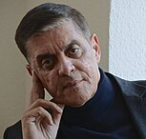
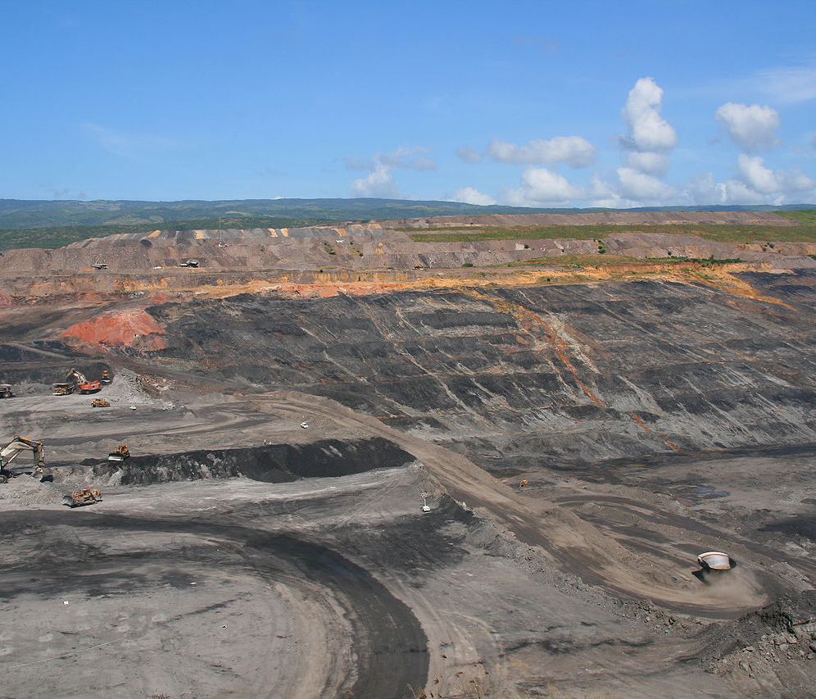
Protest against the Cerrejón coal mine (since 1984)
Cerrejón: South America's largest open-pit coal mine in Colombia
Health hazards and water shortages for surrounding indigenous and Black communities
Threats against and murders of environmental activists
Activism in alliances of indigenous communities and workers, blockades and community empowerment
The Cerrejón Coal Mine
By Tanenhaus - IMG_0523.JPG, CC BY 2.0, https://commons.wikimedia.org/w/index.php?curid=11408769
Notes:
Connection to climate change
Most of the coal from Cerrejón is burned to generate electricity – a key driver of the climate crisis.At the same time, local people are already feeling the severe effects of climate change: heat, water shortages and environmental destruction.
Connection to classism
Those most affected are the indigenous Wayúu and Afro-Colombian communities, who have historically been marginalised and economically disadvantaged. Entire villages have been forcibly relocated to make way for coal mining, and arable land and rivers (e.g. the Río Bruno) have been destroyed. Whilst international corporations profit from coal exports, local people often lack access to clean drinking water, medical care and political participation. The Cerrejón mine epitomises an economy that is harmful to the climate, at the expense of poor, racialised and rural communities. It highlights how closely environmental destruction and social inequality – in other words, climate and classism – are intertwined.
New President: Gustavo Petro -> stronger plans to phase out the fossil fuel industryhttps://www.euronews.com/green/2023/10/21/lost-bones-dreams-and-water-life-and-death-at-the-foot-of-one-of-the-worlds-biggest-coal-mhttps://news.mongabay.com/2021/12/in-colombia-threatened-women-of-the-wayuu-community-continue-to-fight-rampant-mining/https://www.bbc.com/future/article/20221116-how-colombia-plans-to-keep-its-oil-and-gas-in-the-ground

Slide 36
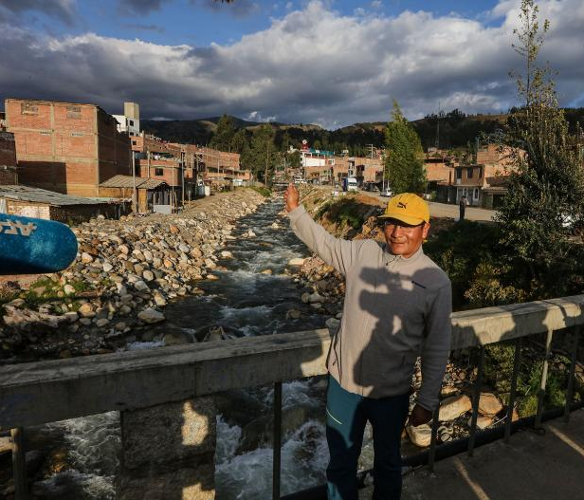
Saúl Luciano Lliuya vs. RWE (2015-2025)
For the first time, a company is sued to take responsibility for the climate change impacts it caused.
Saúl Luciano Lliuya in Huaraz by the stream in which the water from the glacial lake flows through the town.
Foto: Walter Hupiu Tapia / Germanwatch e.V.

Slide 37
Saúl Luciano Lliuya vs. RWE (2015-2025)
Peruvian mountain guides and small farmers sue RWE: Emissions contribute to the melting of a glacier causing flood risk
RWE should contribute to the construction of the dam in the amount of its emissions contribution (0.5%)
Can companies continue to outsource climate impact costs?
Judgement 2025: Individual claim fails, but legal precedent set for corporate CO₂ responsibility
Saúl Luciano Lliuya in Huaraz by the stream in which the water from the glacial lake flows through the town.
Foto: Walter Hupiu Tapia / Germanwatch e.V.
Notes:
24/11/2015 Peruvian mountain guide and small farmer Saúl Luciano Lliuya files a civil lawsuit against RWE at the regional court in Essen. This has become one of the world's most highly regarded precedents for the question of whether individual major emitters must pay for protection against climate risks.
The issue: the construction of a protective dam on the Palcacocha glacial lake above the city in order to protect the plaintiff and over 50,000 people from a flood disaster. Lake has grown considerably due to glacier melt. Boulders could fall in and trigger a flood wave several metres high.
In his lawsuit, Saúl Luciano Lliuya is demanding that the German energy company contribute financially to the necessary protective measures. In fact, in the amount of RWE's share of man-made climate change - around 0.5 per cent. ‘RWE must take responsibility,’ demands the mountain guide. ‘We in Peru have hardly contributed anything to climate change, but we are living with the worst consequences.
Global inequality in climate impacts. AND: Large private companies as emitters, but states and municipalities must pay the costs of adaptation.
Judicial: Action over property (farmer's land) that is under threat. → Ambivalence
First civil action, at the same time also human rights actions, e.g. in the EU, but these are not directed against companies.
Judgement 2025 at Hamm Higher Regional Court:
The court confirmed that RWE could in principle be held liable under civil law as part of a ‘polluter’ for CO₂ emissions
The action failed because Lliuya was unable to provide sufficient evidence that his property was at risk of flooding in concrete terms and with sufficient probability (over a forecast period) - only a risk of approx. 1 % in 30 years was established. 1 % in 30 years was established
Unlike the Regional Court of Essen, the Higher Regional Court of Hamm categorised RWE's CO₂ contribution as causally relevant and spoke of divisible responsibility in accordance with its share of emissions
Conclusion: Individual claim failed, but legal precedent set for CO₂ responsibility of companies - an important milestone in climate law and a possible basis for future claims for damages with more verifiable risks.

Slide 38
The Expulsion of Sinti and Roma (1985)
„The mayor of Darmstadt banished the families that had become homeless to tents on the outskirts of the city, next to the rubbish dump, wastewater filter plant, rat holes and motorway slip roads. Sinti and Roma were stunned by this racism.”
This photograph of members of Roma families standing in front of their destroyed homes, provided by the Documentation and Cultural Centre of German Sinti and Roma, may be used:
https://www.sintiundroma.org/de/set/030803/?id=2619&z=3

Slide 39
Romani Rose (*1946)
Chairman of the Central Council of German Sinti and Roma
House of Sinti*zze and Rom*nja attacked with explosives
Mayor Günther Metzger has the house demolished in the absence of the residents
Intersection of classism and racism
https://commons.wikimedia.org/wiki/File:Romani_Rose.jpg
Notes:
Romani Rose lost 13 family members in concentration camps
Since 70s activist in human rights movement
House of Sinti*zze and Rom*nja attacked with explosives. Mayor Günther Metzger has the house demolished in the absence of the residents
the victims had to search for the remains of their furniture, their copper workshop and even the pictures of their murdered relatives in the dirt
Declaring people to be dirt, dehumanising them: also justifying environmental pollution
https://www.sintiundroma.org/de/ausgrenzung-nach-1945/zentralrat-deutscher-sinti-und-roma/behoerdlicher-rassismus-darmstadt/

Slide 40
Britney Spears, 2013
An image from the music video can be used:
https://static.fabrik.io/zz8/dbdad923faf9de2c.jpg?lossless=1&w=1280&h=1280&fit=max&s=8c0b59051b4d69425076fdc9a8fee77d
“You want a hot body? You want a Bugatti? You want a Maserati?
You better work, bitch”

Slide 41


RuPaul 1992 | Britney Spears, 2013
Actor, Singer & Drag Queen
Got famous with the song Song Supermodel (You better work)
Work for your own self-esteem
Rather used and understood as Empowerment for Queer Community
Work as tool to happiness, beauty and status
Status symbols often harmful to the environment
Work not only as employment, but also as Self-optimization
Capitalism & work ethic reproduced in pop culture
https://de.wikipedia.org/wiki/Britney_Spears
https://commons.wikimedia.org/wiki/File:RuPaul_by_David_Shankbone_cropped.jpg
Notes:
The song depicts a capitalism that constantly surrounds us and holds us accountable if we don't have prestigious car brands or bikini bodies. (Status symbols often harmful to the environment; myth of the ‘self-made (wo)man’)

Slide 42
Sabhar, Bangladesch (24.4.2013)
1136 people die and over 2000 are injured in the collapse of the Rana Plaza textile factory. Afterwards, textile workers are allowed to form independent trade unions for the first time.
An image of the collapsed factory could be used:
https://www.bpb.de/kurz-knapp/hintergrund-aktuell/268127/vor-fuenf-jahren-textilfabrik-rana-plaza-in-bangladesch-eingestuerzt/

Slide 43
Rana Plaza collapse 2013
Cracks already detected the day before
More than 3000 employees forced to work despite a police ban on entering the factory
Mainly production for European fashion companies (Primark, Benetton, Mango, etc.)
Exploitation of workers without regard for their health
Notes:
Global dimension of exploitation,
Organizing of workers as important for labour movement and better working conditions

Slide 44
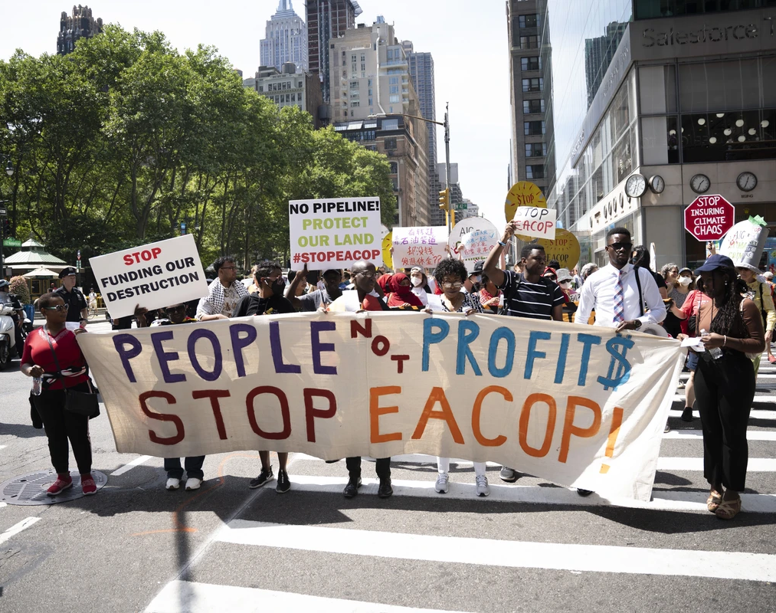
Stop EACOP Protest 2024/2025
“The project threatens to displace thousands of families and farmers from their land. It poses significant risks to water resources and wetlands – including the Lake Victoria basin, which over 40 million people rely upon for drinking water and food production. It would rip through numerous sensitive biodiversity hotspots, and risk significantly degrading several nature reserves crucial to the preservation of threatened elephant, lion and chimpanzee species. And of course, burning more crude oil is the last thing our planet needs!”
https://www.commondreams.org/media-library/opponents-of-eacop-carry-a-banner-in-nyc.jpg?id=52979359&width=1200&height=400&quality= 90&coordinates= 0%2C1124%2C0%2C876
From: https://www.stopeacop.net/why-stop-eacop
Notes:
https://mst.org.br/2025/04/09/this-land-is-our-land/
Photo: MST Archive Recht unklar – erfragt am 04.09 per Mail
Das archiv sagt nur für non-profit und educational reasons. Das bild selber habe ich im Archiv nicht gefundet
Zitat: https://mst.org.br/quem-somos/

Slide 45
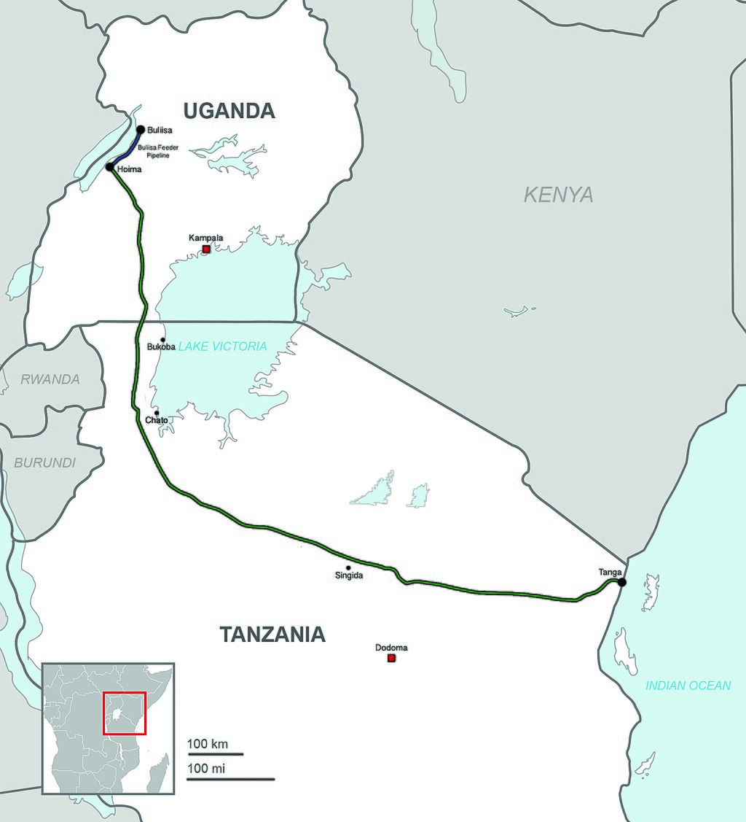
Stop East African Crude Oil Pipeline
Planned Pipeline to transport Crude Oil from Uganda to oil port in Tansania (mainly by French petrol company TotalEnergies)
Displacement; Threats to water ressoruces, nature reserves & livelihoods
34million tons of CO₂ per year
Huge protests agains the project in the region and worldwide
Many banks and insurance companies have withdrawn from the project
https://de.wikipedia.org/wiki/East_African_Crude_Oil_Pipeline#/media/Datei:Uganda-Tanzania_Proposed_Pipeline.jpg
Notes:
Displacement of more than 100,000 people from their land
Threats to water resources, nature reserves & livelihoods
Promotion of export infrastructure that does not benefit the local population
Criminalization and intimidation of local activists
Contradiction to global climate policy: the project would cause 34 million tons of CO₂ per year. 34 million tons of CO₂ per year - equivalent to the emissions of Berlin/year, over 7 million cars or 4 million long-disctance flights - a huge burden on the climate and environment caused by a single major fossil fuel project.
Due to growing concerns over human rights and environmental impacts, many banks and insurers have decided to withdraw their support from the project.

Slide 46






Newsletter: http://buwa-kollektiv.de/newsletter/
www.buwa-kollektiv.de
@buwa_kollektiv
Toolkit available online on our Website
29.05.2024
46

Slide 47
Thank you!
47

